Slide 1
Importance of Turkish
Turkish is a critical-need language in the U.S. supported by four state agencies:
Dept. of State
Dept. of Education
Dept. of Defense
Dir. of Nat’l. Intelligence

Slide 2
Is Turkish taught in American Universities?
Harvard, Yale, UCLA, Stanford, SUNY and many other universities teach Turkish at college level and expanding their programs
Turkish is a key language for many academic positions

Slide 3
Turkish Language Teaching at Universities & Community Colleges
UNIVERSITY OF HOUSTON
Turkish Language
History
SAN ANTONIO COLLEGE
Turkish Culture and Language
TEXAS TECH UNIVERSITY

Slide 4
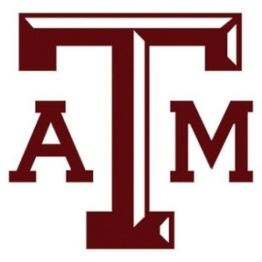
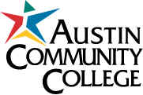
Turkish Language Teaching at Universities & Community Colleges
UNIVERSITY OF ARKANSAS
TEXAS A&M UNIVERSITY
AUSTIN COMMUNITY
COLLEGE

Slide 5
Turkish Language Teaching at Universities & Community Colleges
SOUTHERN METHODIST
UNIVERSITY
UNIVERSITY OF TEXAS –
DALLAS
MILLSAPS COLLEGE
JACKSON

